Slide 1
3rd (or 4th) Mentor Demo
Norbert Szücs
Pallida Cohort - Static Class

Slide 2
4th Week
Pointers
Struct
Biggest challenge
Union, enum
Notes:
How did I defeat this topic

Slide 3
What is a structure?
Collection of variables
User-defined data type
Different types
Under one name in a block of memory

Slide 4
Why is it good?
Store different type of information
Country
Street name
House number
Zip code

Slide 5
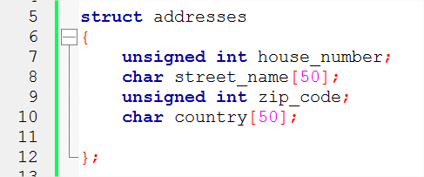
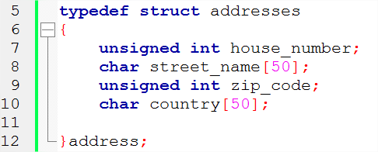
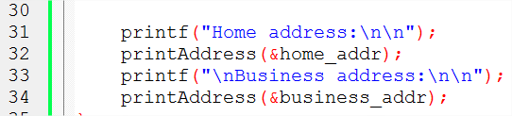
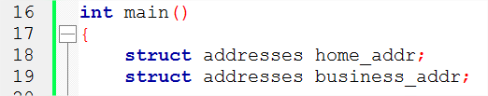
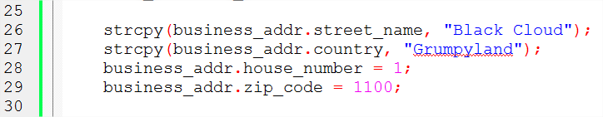
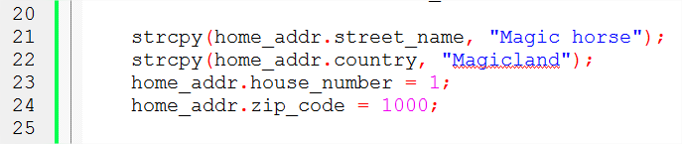
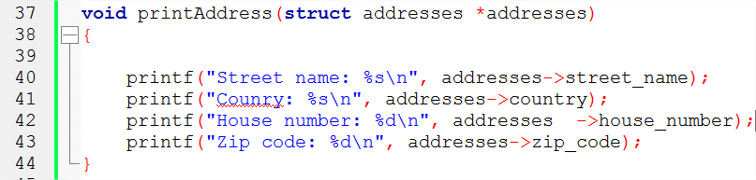
Struct example
Notes:
Struct keyword to create a structure
Created struct addresses as a data type | important, no storage or memory allocated.

Slide 6
Message of the day
Dig deep
Then dig deeper
And deeper…

Slide 7
Thank you for your attention!

